Slide 1
Rasa Food Bot
CMPE 252 Xichang Yu

Slide 2
Can’t decide where to eat? Food bot can help.
Saves user time to decide on what to eat.
Discovers new restaurants and cuisines
Can act as a smart assistant (tells jokes, time, weather, translate….)(in progress)
Web-based app that doesn't need to be downloaded.
Runs fast, low latency.
Can be deployed on platforms such as slack.

Slide 3






Slide 4
DEMO

Slide 5
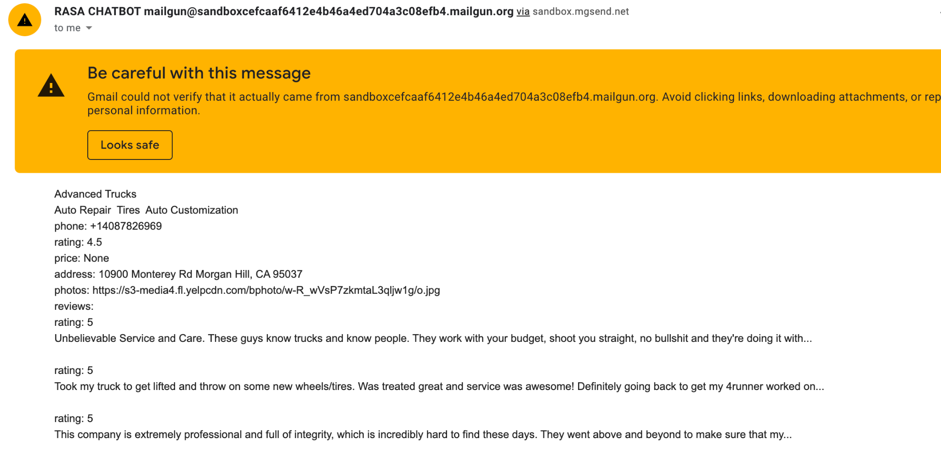

Slide 6
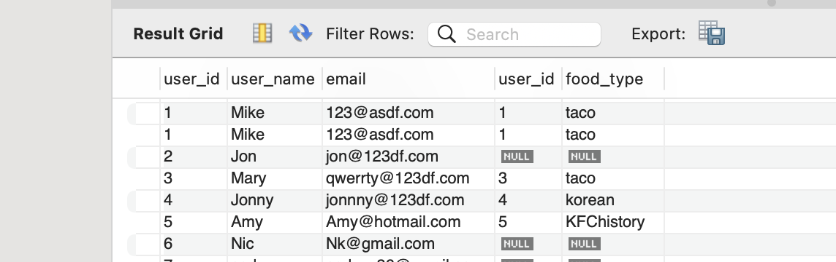

Slide 7
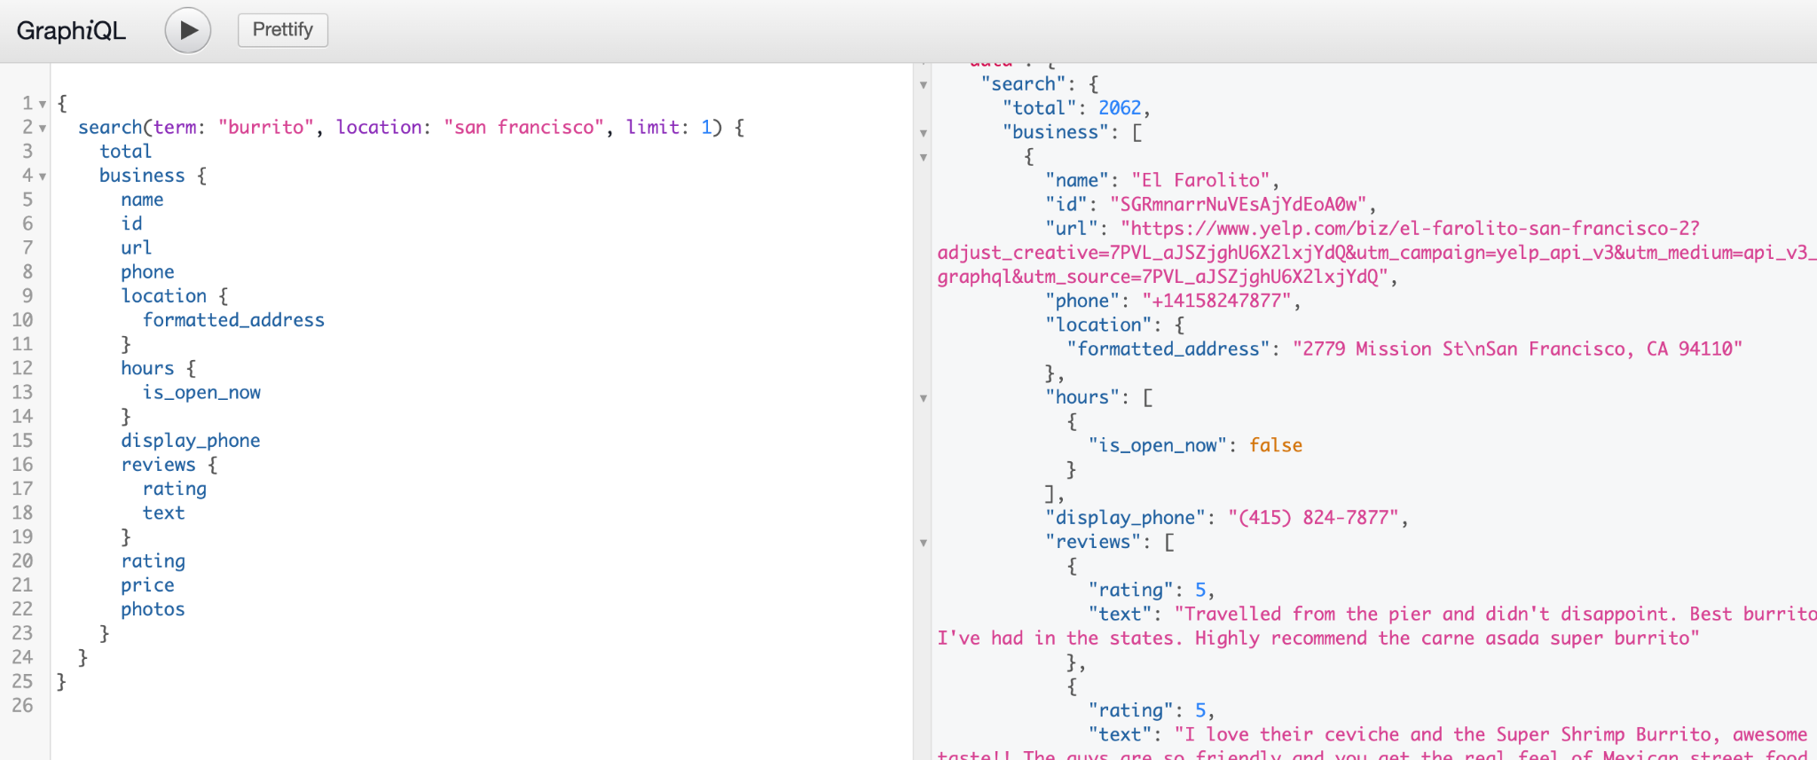

Slide 8
Challenges encountered
Rasa 3.x doesn’t support some of Rasa 2.x syntax.
It takes a lot of efforts to make the bot pick the right intents sometime.
It is hard to construct stories that covers all the conversation scenarios .
It is hard to debug yml files. ( took me hours to find one ‘intent’ labeled as ‘action’)
The bot has a hard time to figure out single words.
Photos doesn’t always show on slack
Plan was to deploy in docker.

Slide 9
Lessons learned
Rasa is an easy-to-use, helpful framework.
Can use it as a future website widget
Be curious about new things, keep learning fun.

Slide 10
Thanks you

